Slide 1
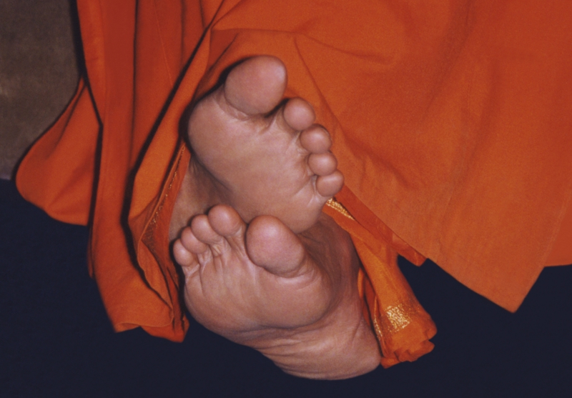
Offering our collective humble Pranams at the divine lotus feet of our beloved Bhagwan.

Slide 2
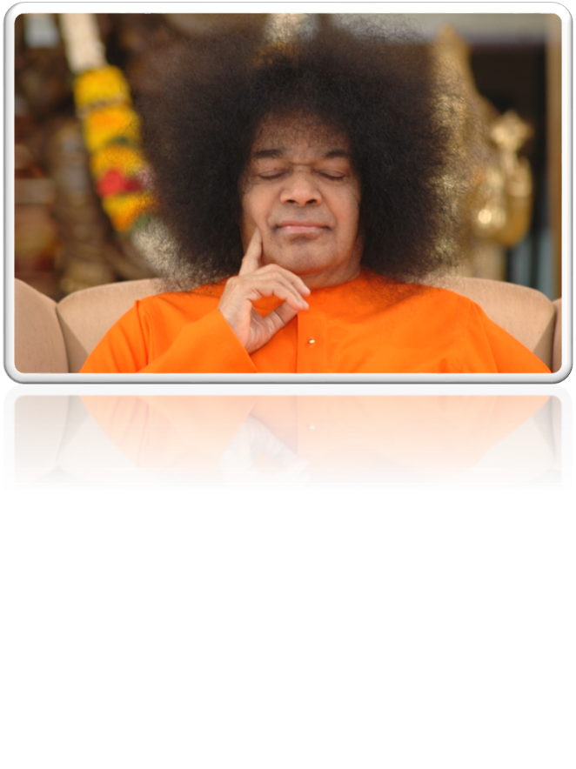
SATYAM SHIVAM SUNDARAM
Aum Sri Sairam

Slide 3
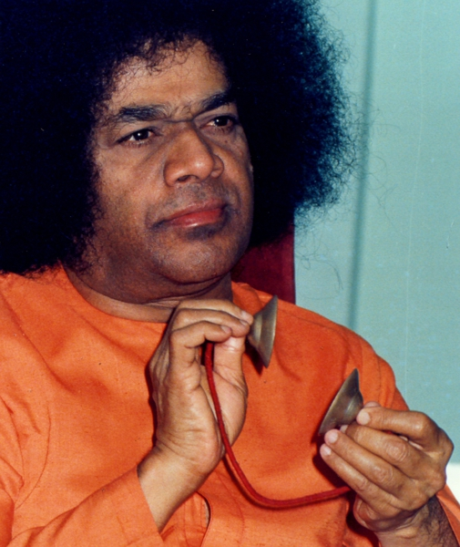
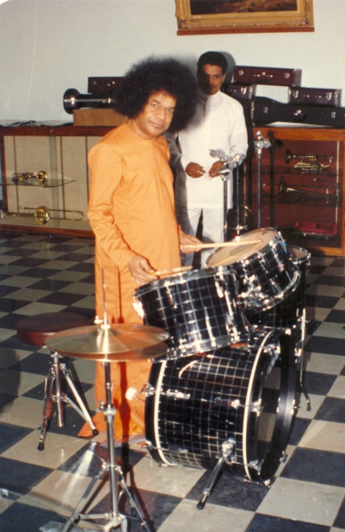
Chapter 3 : Natanamanohara

Slide 4
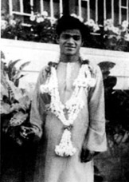
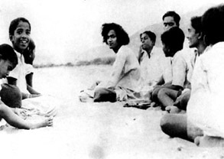
Sathya at the age of 8 years started his higher elementary school at Bukkapatnam, which is about 2 ½ miles away from Puttaparthi. He had to trudge in sun or rain, over stony bunds, with a bag of books, secured on his head. He carried afternoon meal in his bag and, he goes to Bukkapatnam with his friends.
Sri V. C. Kondappa, who found that swami was a divine incarnation as swami’s looks and actions were very much appealing to him. As swami use to guide his classmates and make them do prayers and distribute prasadam’s and he used to distribute things from his empty bag, which he used to describe as “Grama Shakthi”.One of his teachers experienced this grama Shakti on one occasion.

Slide 5
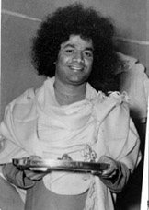
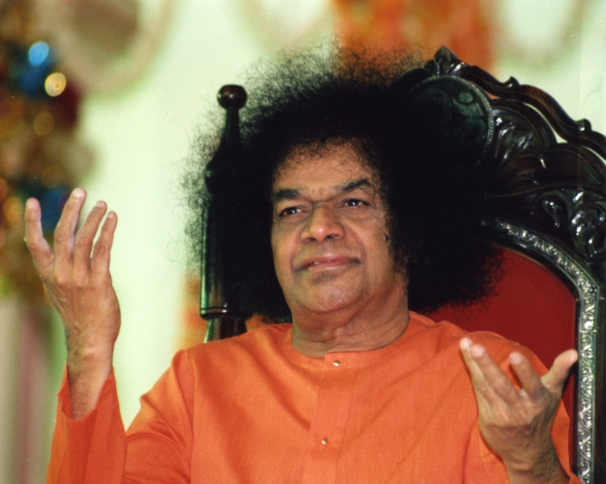
Sri B. Subbannachar, in a book published in 1944. He says that “As a student, He was a simple, unostentatious, honest and well-behaved boy”. Baba was mostly composing bhajana songs, Ashtottara shatanamavalis and copying them and distribute to the whole class.
One day the teacher saw that Sathya was not writing notes, that he was dictating. The teacher shouted “Stand up, all those who are not taking notes!”Teacher asked why he didn’t, Sathya answered nicely in a straight forward way, sir why should I write down? I understood what you dictated ask me any question I will answer.

Slide 6
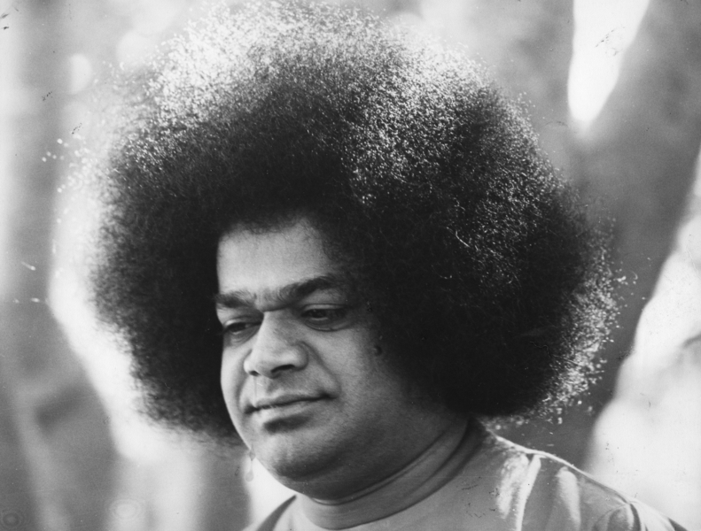
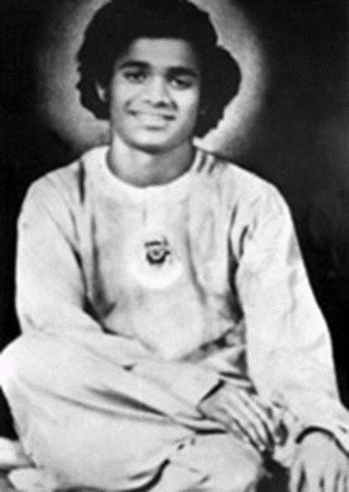
But the pride of the teacher was injured. The teacher said to stand until the last bell rings. Sathya obeyed and stood on the bench. That day no boy in the class was happy. The bell rang and the teacher for the next class came in.
When Mahbub Khan enter the room, he was to find sathyanarayan on the bench and teacher still sitting on the chair. Teacher whispered that when he got up, the chair rose up along with him. The whispered was caught by the boy and he start laughed at the teacher and said it must due to Sathya magic spell. Sir told to Sathya come down immediately, the chair fall and the teacher could move.

Slide 7
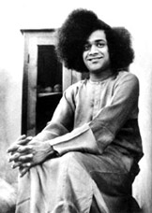
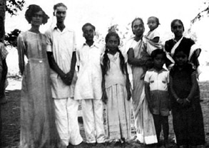
Year later, while relating this story, baba said ; The action is not due to his anger against the teacher,He had no anger in him(teacher), But he wants to prepare men’s minds for the announcement of his mission and identity.
The little prince charming(baba) was even in that tender age a GURU to the children of the village. He is true to the nick name Brahmagyani , which he earned by his Satwic nature.

Slide 8
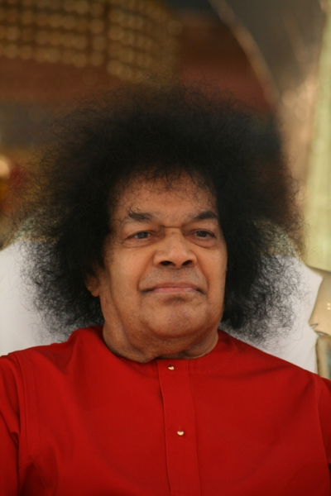
Sathya, even as a child, against all sports and games that caused cruelty or pain. He would not allow his companions to witness the bullock-cart race on the sands of the river-bed held annually on the festival, known as the Big Ekadashi, for He objected to the twisting of tails and the flaying with sticks, for the vicarious glory of the master. Bear-baiting, cock fighting, and such other village entertainments, He condemned, as the "Guru" of his group.
Sathya grew in the midst of about eighteen to twenty children, It was necessary to be a clean and straight child in order to win Sathya's appreciation. Kondama Raju once told the present writer how, when the tailor was called in to stitch shirts for all the children out of various types of coloured cloth that had been brought from the Bukkapatnam shanty, Sathya would say, "Let everyone be given the cloth he selects; what remains is good enough for

Slide 9
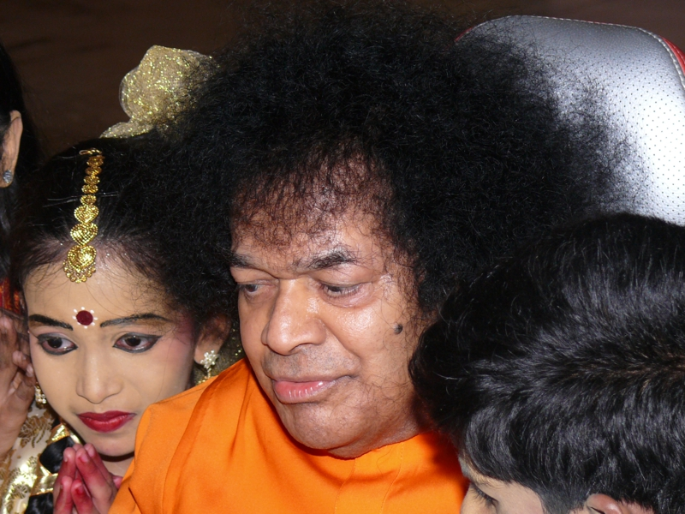

Pedda Venkapa Raju tried often to take Sathya too along with the other children to the touring talkie for seeing pictures; but, He protested and refused. He spoke of the degraded ideals of the cinemas, how they vulgarised the Gods and music; in order to accumulate money.
Sathya formed "Pandhari Bhajan" group on the model of such as existed in some neighbouring villages. The group consisted of about sixteen to eighteen boys, dressed uniformly in gerua clothes, holding each a flag in the hand and wearing jingle-bell-anklets. They all danced to the tune of picturesque folk-songs and ballads, describing the yearning of pilgrims for Panduranga's darshan.

Slide 10
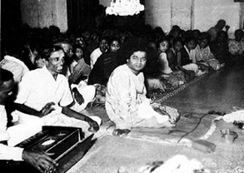
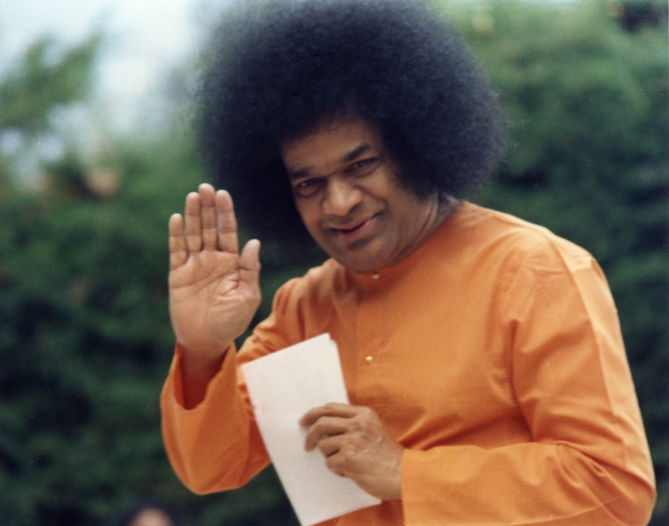
Sathya added some Bhagavata songs of His own in which Yashoda and Krishna in the centre of the circle and with the Gopis dancing on the circumference, this was a great attraction in the village. Baba Himself played the role of either the mother or the child and His dance, dialogue and music added to the charm of the Bhajan.
"Sai Baba? Sai Baba of Shirdi? Who could it be? How did this little boy get inspired by that Muslim, a Fakir?" The elders wondered, as the children danced in the streets.

Slide 11
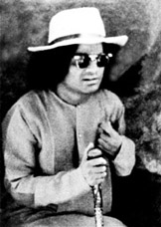
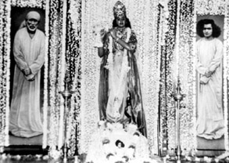
Sathya was the central figure of the group, as he did every role so wonderfully that the village could feel Mathura and Brindavan reproduced, and Balagopala with His flute enchanting the Gopis.
The villagers, too, heard the strange names, Shirdi and Sai, wondered what and who they were. Then, there were the dramas, the open-air operas, where puranic themes were represented by dialogue, dance and costume; where rakshasas, asuras and the powers of evil were defeated by Gods, avatars and the forces of good.

Slide 12
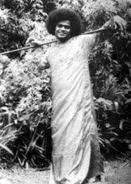
The dramas was prepared in the household in which Sathya moved ; Pedda Venkapa Raju himself had become a celebrity on the popular stage.A number of plays were produced at this period, in order to collect funds for famine relief.
Once, while a song describing the prowess and achievements of Lord Narasimha of Kadiri, which was recited by the group of boys, Sathya suddenly leaped like the Lion-man Manifestation of the Lord and His face was transformed into such ferocity and at last, after a number of people had offered puja, Sathya became normal. This incident spread the fame of the Pandhari Bhajan Group.

Slide 13
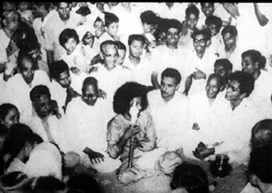
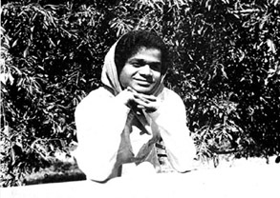
It was noticed that when an infection of cholera swept like a poisonous simoom over the surrounding villages, Puttaparthi did not feel the blast of death because of the Divine atmosphere generated by the Bhajan group. The boys were invited to a large number of villages. People sent their bullock carts to bring the group; but sometimes, they had to walk long distances.
The audiences applauded for, the rhythm in Sathya’s feet, a sense of time and tune, they had seldom seen. A litheness and a loveliness, which made them feel that he never touched the earth, he belonged to some ethereal region!

Slide 14
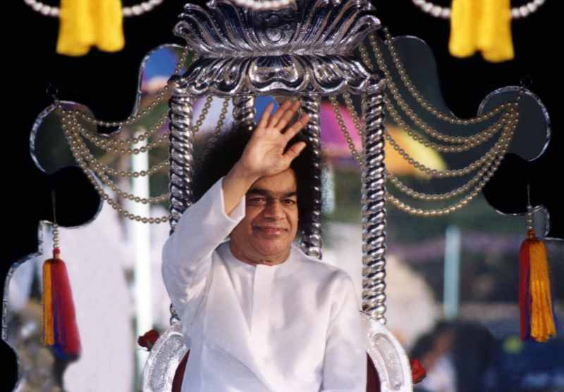
Thank you

Slide 15
Group Members :-
Aryan Bhandari
Chaitanya
Nikhil Bisht
Sujal Prasad
Jaswanth Roy

